Slide 1
[CSED211] Introduction to Computer Software Systems
Lab 3: Bomb Lab
Prof. Jisung Park
Seunghun Oh
2024.09.26

Slide 2
Today’s Agenda
Machine Code and Assembly Language
Bomb Lab Overview
GDB
Practice with TA
Special Session

Slide 3














Course Objective: Understand How Computers Work
What is a computer?
A machine that computes data
To solve important problems
To improve our lives (happier, more pleasant, more convenient, etc.)
We are using computers every day for various purposes in our life
Online Shopping
Communication
Traffic Systems
Medical Systems
Finance Systems
Entertainment & Media

Slide 4

Course Objective: Understand How Computers Work
How does a computer work?
It runs programs
i.e., software implemented using (high-level) programming languages
On systems that consist of hardware and system software
Okay, but how?
Logical Descriptions

Slide 5

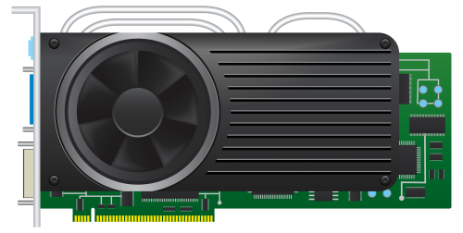
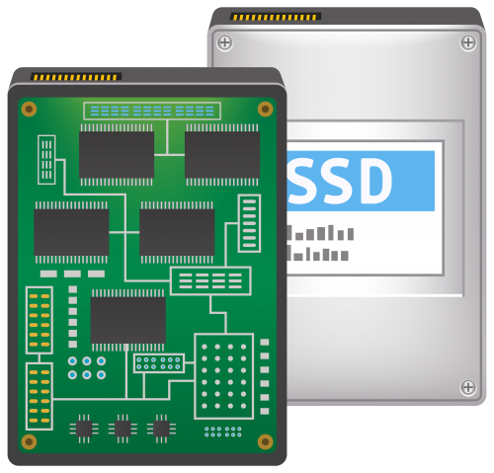
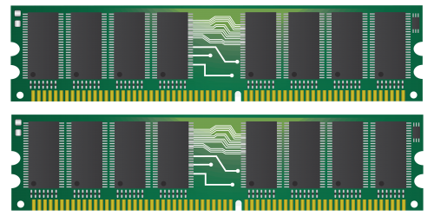
Course Objective: Understand How Computers Work
How does a computer work?
It runs programs
i.e., software implemented using (high-level) programming languages
On systems that consist of hardware and system software
Okay, but how?
Logical Descriptions
Hardware (Electronic Devices)

Slide 6
Course Objective: Understand How Computers Work
A program gets translated into a set of instructions, i.e., machine code
Which encode appropriate electrical signals (binary representation: 0 or 1)
Executed by CPU and stored in memory/storage
*return_value = result;
010010001000100100000011
Okay, but how?
Logical Descriptions
Hardware (Electronic Devices)

Slide 7

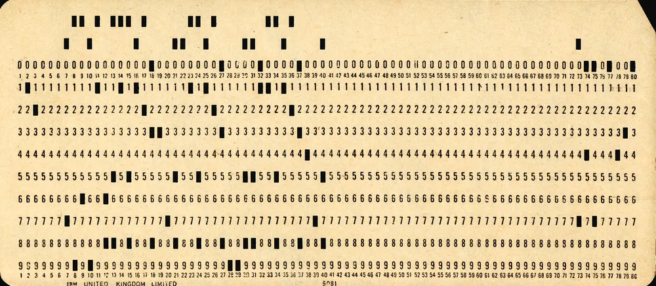
Course Objective: Understand How Computers Work
A program gets translated into a set of instructions, i.e., machine code
Which encode appropriate electrical signals (binary representation: 0 or 1)
Executed by CPU and stored in memory/storage
Back in the old days, human needs to
directly write machine code
*return_value = result;
010010001000100100000011
Logical Descriptions
Hardware (Electronic Devices)

Slide 8

Course Objective: Understand How Computers Work
A program gets translated into a set of instructions, i.e., machine code
Which encode appropriate electrical signals (binary representation: 0 or 1)
Executed by CPU and stored in memory/storage
*return_value = result;
010010001000100100000011
Logical Descriptions
Compiler
Hardware (Electronic Devices)

Slide 9
Course Objective: Understand How Computers Work
A program gets translated into a set of instructions, i.e., machine code
Which encode appropriate electrical signals (binary representation: 0 or 1)
Executed by CPU and stored in memory/storage
Assembly language: Text representation of machine code
*return_value = result;
movq %rax, (%rbx)
010010001000100100000011
Logical Descriptions
Compiler
Hardware (Electronic Devices)

Slide 10
Why Understand How Computers Work?
Compilers are much better than humans at machine-code translation
But it is still important to understand how your program will get translated and executed in computer systems
Enables you to be a better computer scientist or computer engineer
Who can optimize your program to improve performance and energy efficiency
Not a run-of-the-mill programmer or just a coder

Slide 11
Today’s Agenda
Machine Code and Assembly Language
Bomb Lab Overview
GDB
Practice with TA
Special Session

Slide 12
Bomb Lab: Overview
A popular open-source assignment
Developed by Randal E. Bryant and David R. O’Hallaron at CMU in 2002
Widely used around the world due to its effectiveness
Through this lab, students can learn
Understanding Program Execution: Control Flow and Logic
Reverse Engineering
Debugging and Disassembly
Assembly Language
Notes:
슬라이드 구성에 대한 부분 bomb lab의 general한 부분이 들어가도록

Slide 13
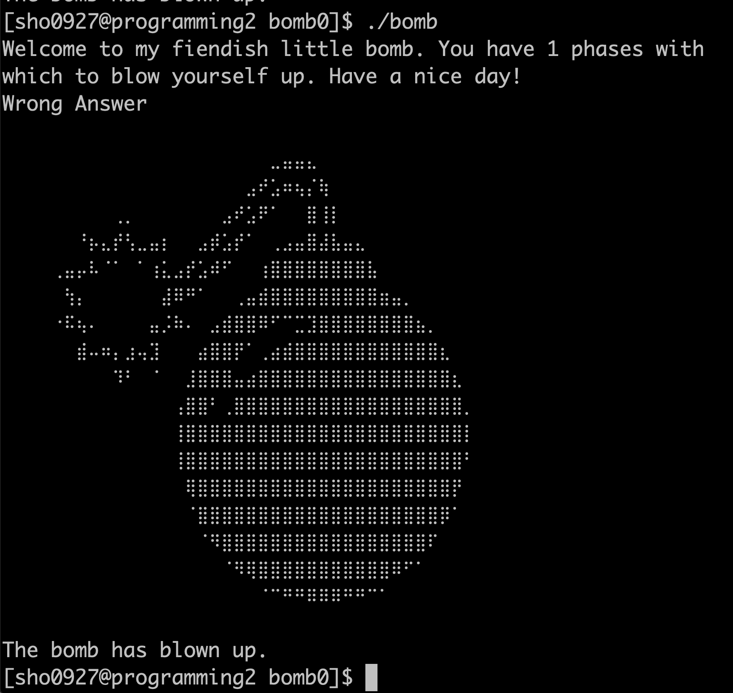
Bomb Lab: Overview
Objective: Defuse a binary bomb by providing correct input (password)
Wrong Answer
Notes:
슬라이드 구성에 대한 부분 bomb lab의 general한 부분이 들어가도록

Slide 14
Today’s Agenda
Machine Code and Assembly Language
Bomb Lab Overview
GDB
Practice with TA
Special Session

Slide 15
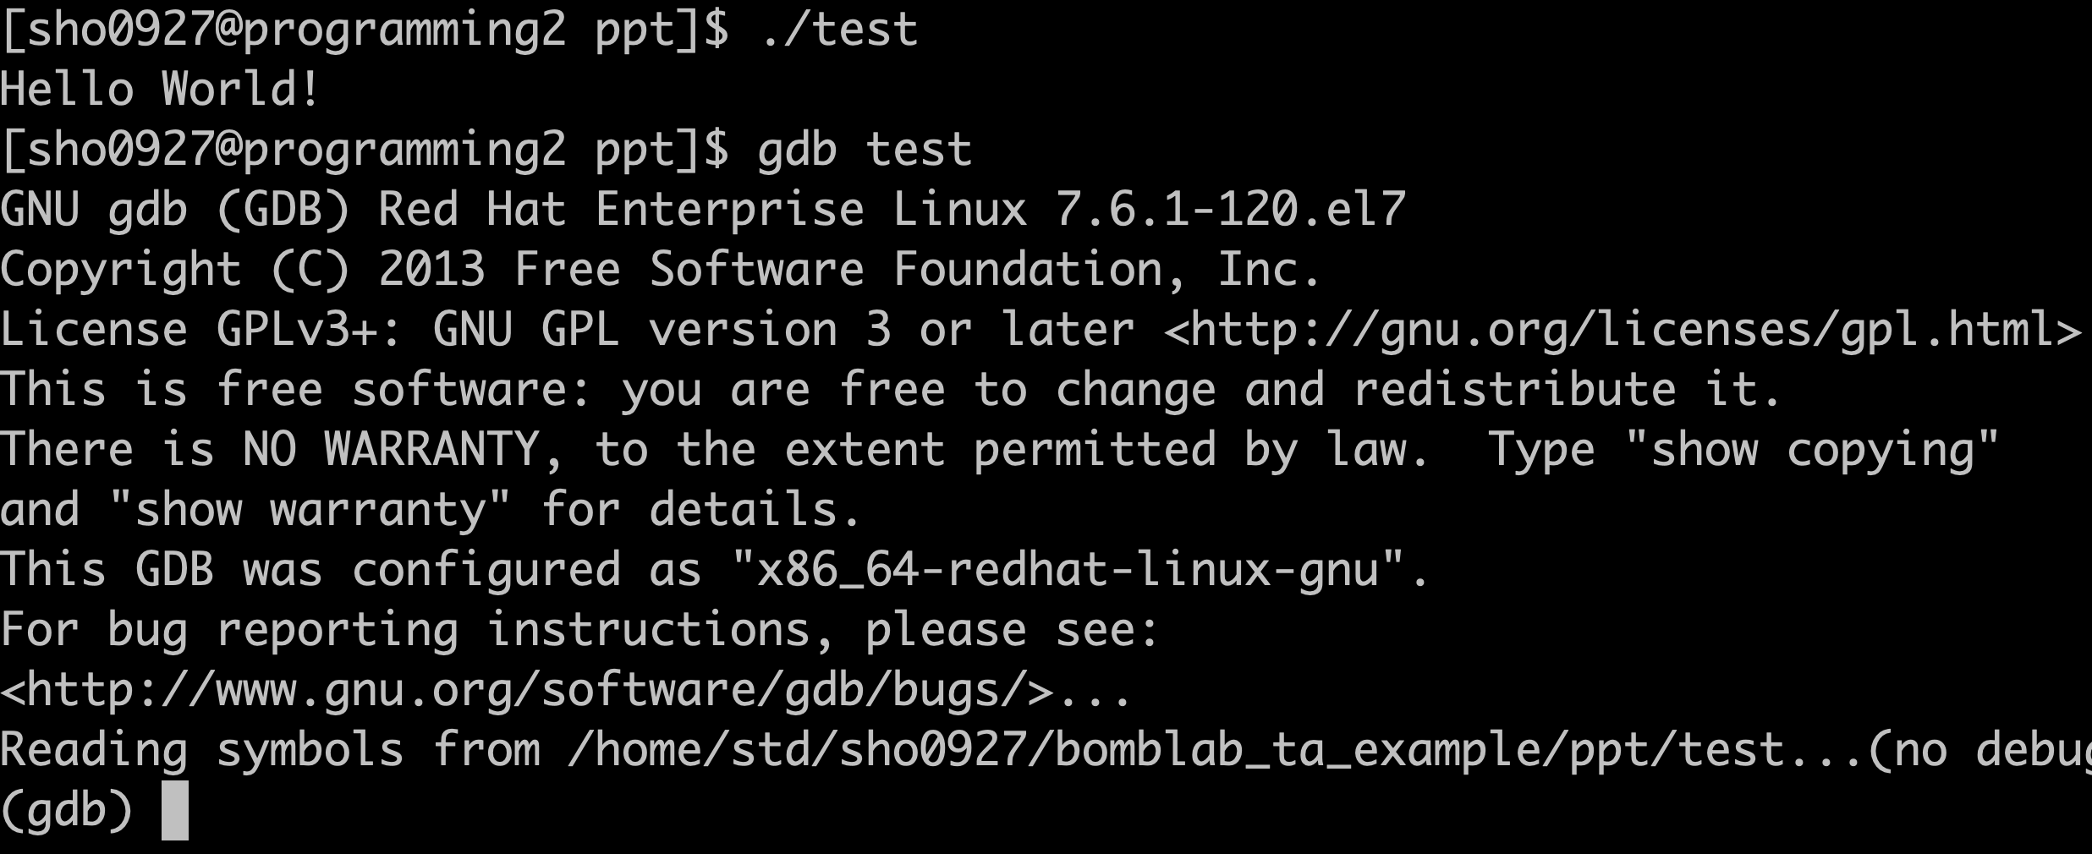
GDB
GNU project debugger
Allows you to see what is going on inside a target program during its execution
How to execute the target program over GDB?
Run the target program (execfile) over GDB
$ gdb [execfile]

Slide 16
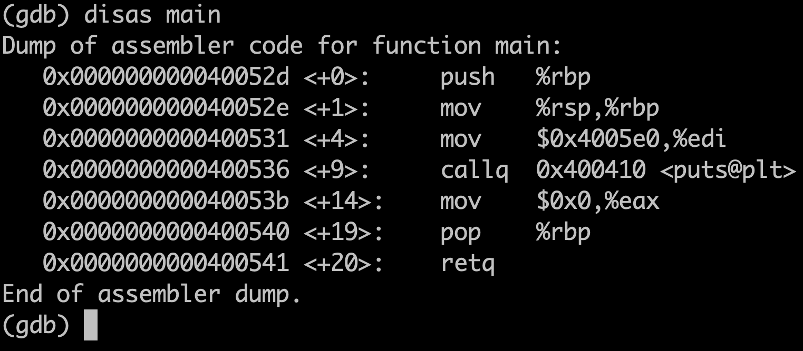
GDB Commands
disassemble (disas): Disassemble a specific function by name (e.g., main)
(gdb) disas main
run (r): Run the program
(gdb) r
Kill the current running program and re-run the program (e.g., restart)
Notes:
마우스로 드래그 선택 절대 하지 말기
마우스가 움직이면 청자에게 distract할 수 있다. 드래그 선택 절대 안 하는게 좋음 / 천천히 마우스를 돌려주기
이렇게 하면 밖에서 설정한 것들과 동일하다. 근데 우리는 분석하는 것이 목표이니까 프로그램 실행 중간에 멈출 수 있게 설정을 해줘야한다.
이게 브레이크입니다.

Slide 17
GDB Commands
break (b): Set a breakpoint at a specific memory address
(gdb) b *main # The function name is pointer to memory address
(gdb) b *main+1
(gdb) b *0x400536
If you have set any breakpoints, GDB will stop at the first breakpoint
continue (c): Continue the program
(gdb) c
Resume program execution from the current point to the next breakpoint or endpoint
si [step instruction], ni [next instruction]: Execute next instruction
(gdb) si # Step into the procedure call
(gdb) ni # Next after finishing procedure call
Notes:
Break를 셋팅하고 다시 run을 해주는데 출력이 안되고, 멈춰있고, behavior가 다른 것을 알 수 있다.
Si, ni에 대한 설명이 직관적이지 않아서, 다른 방법을 찾았으면 좋겠다.
Si – ni 모두 똑같다. 근데 언제 달라지냐면 procedure을 만났을 때만이다.
Si는 call procedure로 들어간다.
Ni는 call에 있는 procedure을 모두 끝내고 call 다음에 있는 instruction으로 넘어간다.

Slide 18
GDB Commands
info (i): Print various debugging information
(gdb) i [option]
[Command option]
registers (r), breakpoints(b) …
clear (cl): Clear a breakpoint specified by given memory address
(gdb) cl *main
delete (d): Delete a breakpoint specified by given number (all if number is not given)
(gdb) d 2
(gdb) d # Delete all breakpoints
kill (k): Kill the current running program
(gdb) k

Slide 19
GDB Commands
print (p): Print current register value
(gdb) p $rax
x: Examine contents of memory
(gdb) x/[option] [addr]
[Command option]
What granularity do you want to display memory values: [b(1), h(2), w(4), g(8)]
What format should the contents be displayed in: [t₍₂₎, o₍₈₎, u₍₁₀₎, x₍₁₆₎]
Show the values in ASCII code format until a NULL value is encountered: [s]
Examples:
x/gx 0x400
x/2wt 0x400
x/s 0x400
Address | 0x400 | 0x401 | 0x402 | 0x403 | 0x404 | 0x405 | 0x406 | 0x407 | 0x408
Value | 0x41 | 0x42 | 0x43 | 0x44 | 0x45 | 0x46 | 0x47 | 0x48 | 0x00
Address | 0x400 | 0x401 | 0x402 | 0x403 | 0x404 | 0x405 | 0x406 | 0x407 | 0x408
Value | 0x41 | 0x42 | 0x43 | 0x44 | 0x45 | 0x46 | 0x47 | 0x48 | 0x00
Address | 0x400 | 0x401 | 0x402 | 0x403 | 0x404 | 0x405 | 0x406 | 0x407 | 0x408
Value | 0x41 | 0x42 | 0x43 | 0x44 | 0x45 | 0x46 | 0x47 | 0x48 | 0x00
Address | 0x400 | 0x401 | 0x402 | 0x403 | 0x404 | 0x405 | 0x406 | 0x407 | 0x408
Value | 0x41 | 0x42 | 0x43 | 0x44 | 0x45 | 0x46 | 0x47 | 0x48 | 0x00
$ (gdb) x/gx 0x400 0x4847464544434241
$ (gdb) x/s 0x400 “ABCDEFGH”
$ (gdb) x/2wt 0x400 01000100010000110100001001000001 01001000010001110100011001000101
Notes:
B, h, w, g → byte, half word, word, giant(double world)
T, o, u, x → binary(two), octal, unsigned decimal, hexadecimal
Info로도 register를 볼 수 있지만 각각의 register value를 보고 싶을 때 사용한다.
레지스터에도 값을 저장하지만 메모리에도 값을 저장하니까, 그걸 보고 싶으면 x이다.
ASCII code or 문자로 보여준다는 것
Little endian이라서 저장 순서가 LBS가 가장 작은 주소값에 적히는 것

Slide 20
Today’s Agenda
Machine Code and Assembly Language
Bomb Lab Overview
GDB
Practice with TA
Special Session

Slide 21
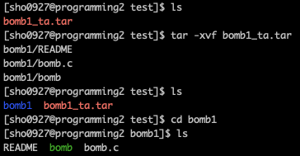
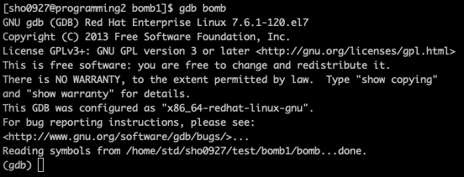
Practice with TA
Unzip your bomb
$ tar -xvf bomb#.tar
Check bomb.c source file
$ vim bomb.c
Use gdb to solve bomb
$ gdb bomb
Notes:
Bomb.c의 main함수만 있고 안쪽은 없다.

Slide 22
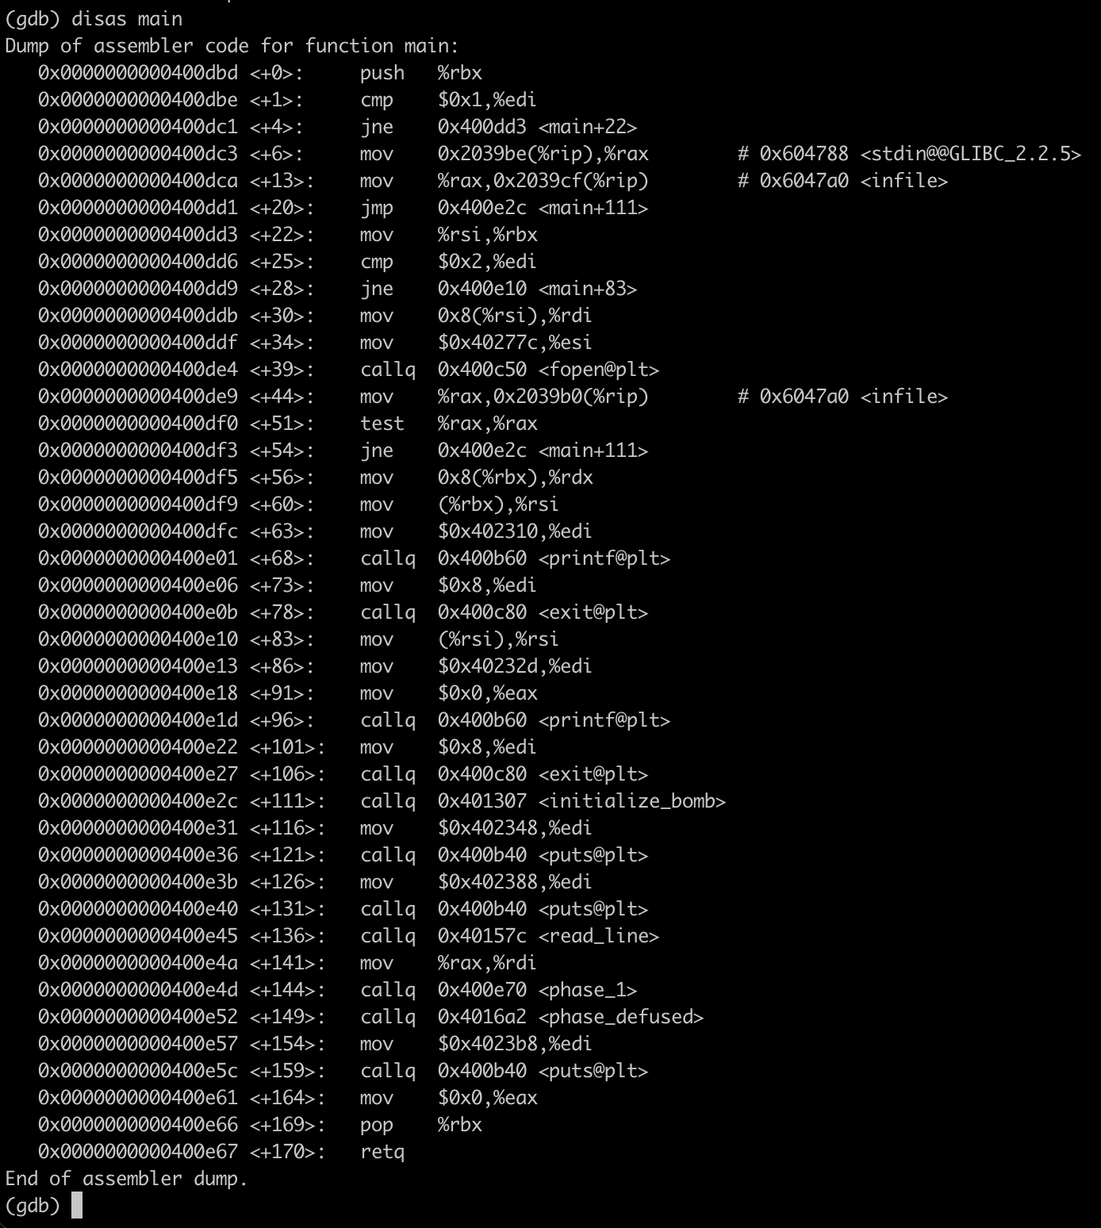
Practice with TA (Cont’d)
Disassemble main
(gdb) disas main
# In bomb.c
char *input;
input = read_line();
phase_1(input);
phase_defused();
RSP | RAX | RBX | RBP | RDI
? | input | ? | ? | input
RSI | RDX | RCX | R8 | R9
? | ? | ? | ? | ?
Initialize
bomb
RSP | RAX | RBX | RBP | RDI
? | input | ? | ? | ?
RSI | RDX | RCX | R8 | R9
? | ? | ? | ? | ?
phase_1
Notes:
Xshell을 항상 consistency를 맞춰달라
Compiler할 때 –g option을 줬기 때문에 함수의 label이 잘 나와있고, 이걸 바탕으로 대강 어떤 일이 이뤄지고 있는지를 파악해야한다.
질문 들어올경우 → -g option은 debugging 정보를 포함하는 옵션이고, 소스코드의 라인 번호 + 변수 이름 + 함수 이름 등과 같은 정보가 포함됨
Fopen이나 print와 같은 library 함수들도 있지만 Initialize_bomb과 같이 특별한 함수들이 있음
Initialize bomb을 빼고 read_line 먼저 보자
bomb.c의 main을 먼저 보여주자
I r로 RAX, RDI가 같다는거 breakpoint 걸어서 보여주는건 어떤가?

Slide 23
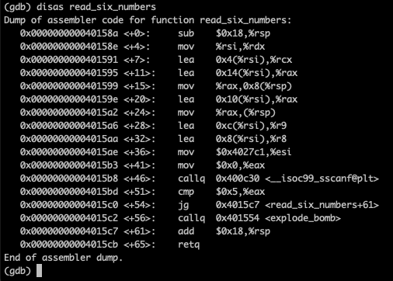
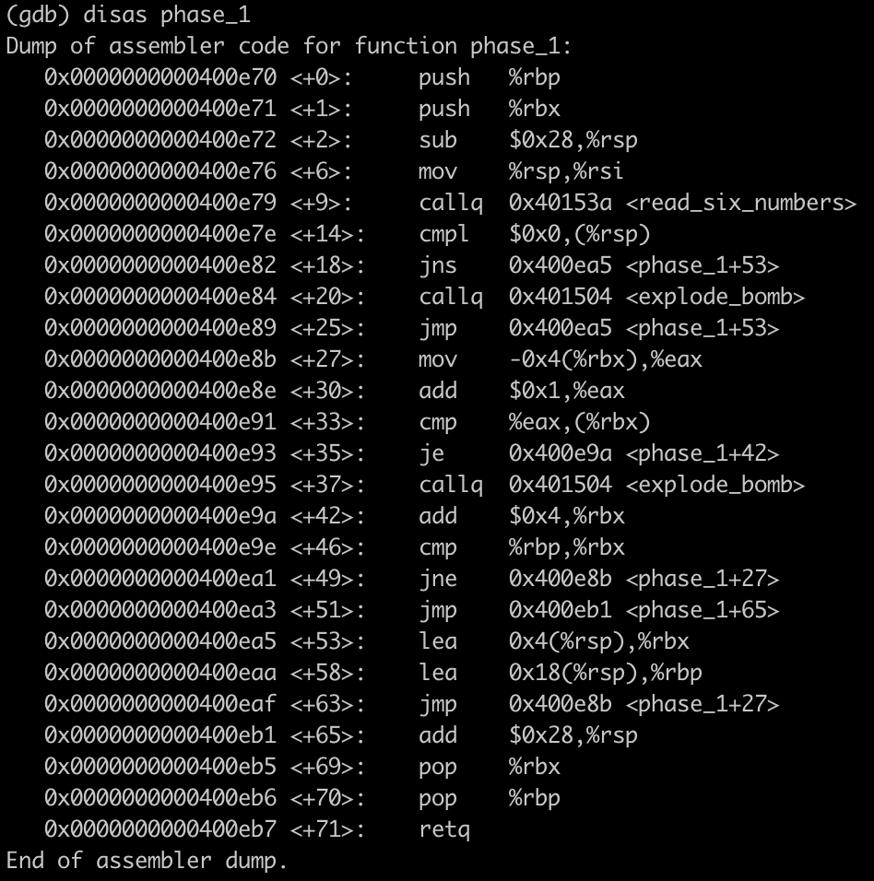
Practice with TA (Cont’d)
Disassemble phase 1
(gdb) disas phase_1
RSP | RAX | RBX | RBP | RDI
? | input | ? | ? | input
RSI | RDX | RCX | R8 | R9
? | ? | ? | ? | ?
Notes:
Main처럼 함수들을 먼저 보고, read_six_numbers라는 함수도 있고, explode bomb이라는 함수도 있다.
Read에서도 터질 수도 있다.
폭탄을 한 번 터트려 보는건 어떤가?
Explode_bomb 함수에 대한 설명을 터트림으로써 보여주는 것은 어떨까?

Slide 24
Practice with TA (Cont’d)
Disassemble phase 1
(gdb) disas phase_1
RSP | RAX | RBX | RBP | RDI
p | input | ? | ? | input
RSI | RDX | RCX | R8 | R9
? | ? | ? | ? | ?
RSP | RAX | RBX | RBP | RDI
p - 40 | input | ? | ? | input
RSI | RDX | RCX | R8 | R9
? | ? | ? | ? | ?
RSP | RAX | RBX | RBP | RDI
p - 40 | input | ? | ? | input
RSI | RDX | RCX | R8 | R9
p - 40 | ? | ? | ? | ?
RSP | RAX | RBX | RBP | RDI
? | input | ? | ? | input
RSI | RDX | RCX | R8 | R9
? | ? | ? | ? | ?

Slide 25
Practice with TA (Cont’d)
Disassemble phase 1
(gdb) disas phase_1
lea 0x4(%rsi), %rcx
mov %rsi, %rdx
RSP | RAX | RBX | RBP | RDI
p - 64 | input | ? | ? | input
RSI | RDX | RCX | R8 | R9
p - 40 | p - 40 | p - 36 | ? | ?
RSP | RAX | RBX | RBP | RDI
p - 64 | 0 | ? | ? | input
RSI | RDX | RCX | R8 | R9
0x4027c1 | p - 40 | p - 36 | p - 32 | p - 28
RSP | RAX | RBX | RBP | RDI
p - 64 | input | ? | ? | input
RSI | RDX | RCX | R8 | R9
p - 40 | p - 40 | ? | ? | ?
RSP | RAX | RBX | RBP | RDI
p - 64 | input | ? | ? | input
RSI | RDX | RCX | R8 | R9
p - 40 | ? | ? | ? | ?
Notes:
Lea, mov관련하여 설명해주기

Slide 26
Practice with TA (Cont’d)
Disassemble phase 1
(gdb) disas phase_1
int sscanf(char* input, char* format, D_Type* data_1, D_Type* data_2, …)
RSP | RAX | RBX | RBP | RDI
p - 40 | 6 | ? | ? | input
RSI | RDX | RCX | R8 | R9
0x4027c1 | p - 40 | p - 36 | p - 32 | p - 28
 | &1st Input | &2nd Input | &3rd Input | &4th Input
RSP | RAX | RBX | RBP | RDI
p - 64 | # of Input | ? | ? | input
RSI | RDX | RCX | R8 | R9
0x4027c1 | p - 40 | p - 36 | p - 32 | p - 28
 | &1st Input | &2nd Input | &3rd Input | &4th Input
RSP | RAX | RBX | RBP | RDI
p - 64 | 0 | ? | ? | input
RSI | RDX | RCX | R8 | R9
0x4027c1 | p - 40 | p - 36 | p - 32 | p - 28
Notes:
sscanf관련한 설명이 너무 길다.
예제랑 같이 다른 슬라이드를 만들어서 scanf는 다 아는데 scanf는 standard input을 받아오는건데 format을 바탕으로 값을 받아오는건데, sscanf는 입력된게 아니라 이미 있는 문자열이면 이렇게 받을 수 있다.
즉 봐야할 것은 두 번째 인자겠네요?
두 번째 인자는 0x4027c1에 있으니까 이거 확인해보고 6개 인자 받고 넘어가는거겠네요?
그리고 저장되는 주소가 3번째 인자부터 있으니까 ~~

Slide 27
Practice with TA (Cont’d)
Disassemble phase 1
(gdb) disas phase_1
cmpl $0x0, (%rsp) #(%rsp) - $0x0
jns 0x400ea5 # Jump if SF is not set
RSP | RAX | RBX | RBP | RDI
p - 40 | 6 | ? | ? | input
RSI | RDX | RCX | R8 | R9
0x4027c1 | p - 40 | p - 36 | p - 32 | p - 28
 | &1st Input | &2nd Input | &3rd Input | &4th Input
Notes:
Cmpl → 32bit를 명시해주기 위함이라고 함

Slide 28
Practice with TA (Cont’d)
Disassemble phase 1
(gdb) disas phase_1
RSP | RAX | RBX | RBP | RDI
p - 40 | 6 | ? | ? | input
RSI | RDX | RCX | R8 | R9
0x4027c1 | p - 40 | p - 36 | p - 32 | p - 28
 | &1st Input | &2nd Input | &3rd Input | &4th Input
RSP | RAX | RBX | RBP | RDI
p - 40 | 6 | p - 36 | p - 16 | input
RSI | RDX | RCX | R8 | R9
0x4027c1 | p - 40 | p - 36 | p - 32 | p - 28
 | &1st Input | &2nd Input | &3rd Input | &4th Input

Slide 29
Practice with TA (Cont’d)
Disassemble phase 1
(gdb) disas phase_1
cmp %eax, (%rbx) #(%rbx) - %eax
je 0x400e9a # Jump if ZF is set
RSP | RAX | RBX | RBP | RDI
p - 40 | 6 | p - 36 | p - 16 | input
RSI | RDX | RCX | R8 | R9
0x4027c1 | p - 40 | p - 36 | p - 32 | p - 28
 | &1st Input | &2nd Input | &3rd Input | &4th Input
RSP | RAX | RBX | RBP | RDI
p - 40 | *(p - 40) | p - 36 | p - 16 | input
RSI | RDX | RCX | R8 | R9
0x4027c1 | p - 40 | p - 36 | p - 32 | p - 28
 | &1st Input | &2nd Input | &3rd Input | &4th Input
RSP | RAX | RBX | RBP | RDI
p - 40 | *(p - 40) + 1 | p - 36 | p - 16 | input
RSI | RDX | RCX | R8 | R9
0x4027c1 | p - 40 | p - 36 | p - 32 | p - 28
 | &1st Input | &2nd Input | &3rd Input | &4th Input

Slide 30
Practice with TA (Cont’d)
Disassemble phase 1
(gdb) disas phase_1
$ (gdb) 1 2 3 4 5 6
Phase 1 defused.
RSP | RAX | RBX | RBP | RDI
p - 40 | *(p - 40) + 1 | p - 36 | p - 16 | input
RSI | RDX | RCX | R8 | R9
0x4027c1 | p - 40 | p - 36 | p - 32 | p - 28
 | &1st Input | &2nd Input | &3rd Input | &4th Input
RSP | RAX | RBX | RBP | RDI
p - 40 | *(p - 40) + 1 | p - 32 | p - 16 | input
RSI | RDX | RCX | R8 | R9
0x4027c1 | p - 40 | p - 36 | p - 32 | p - 28
 | &1st Input | &2nd Input | &3rd Input | &4th Input

Slide 31
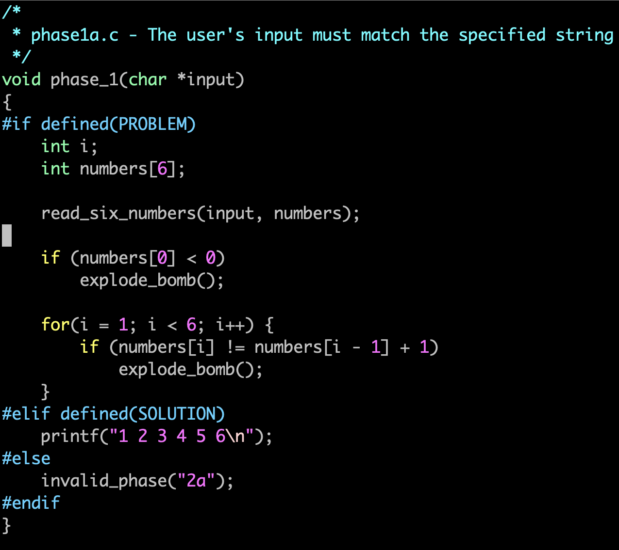
Practice with TA (Cont’d)
The orignal c code of TA session phase_1

Slide 32
Today’s Agenda
Machine Code and Assembly Language
Bomb Lab Overview
GDB
Practice with TA
Special Session

Slide 33
Competition
The same binary bomb will be provided to all team
Your goal is to defuse bomb by giving correct input
There is no penalty for exploding bomb
You will have a total of 20 minutes to defuse your bomb
Teams that defuse the bomb get a chance to present their solution (Extra Credit / 2% of your total bomb lab score)
Explain the phase of provided bomb
Describe where to get clue for defusing bomb
Provide answer of the bomb
Each team can only use one desktop
Internet search only allows to search for unknown instructions

Slide 34
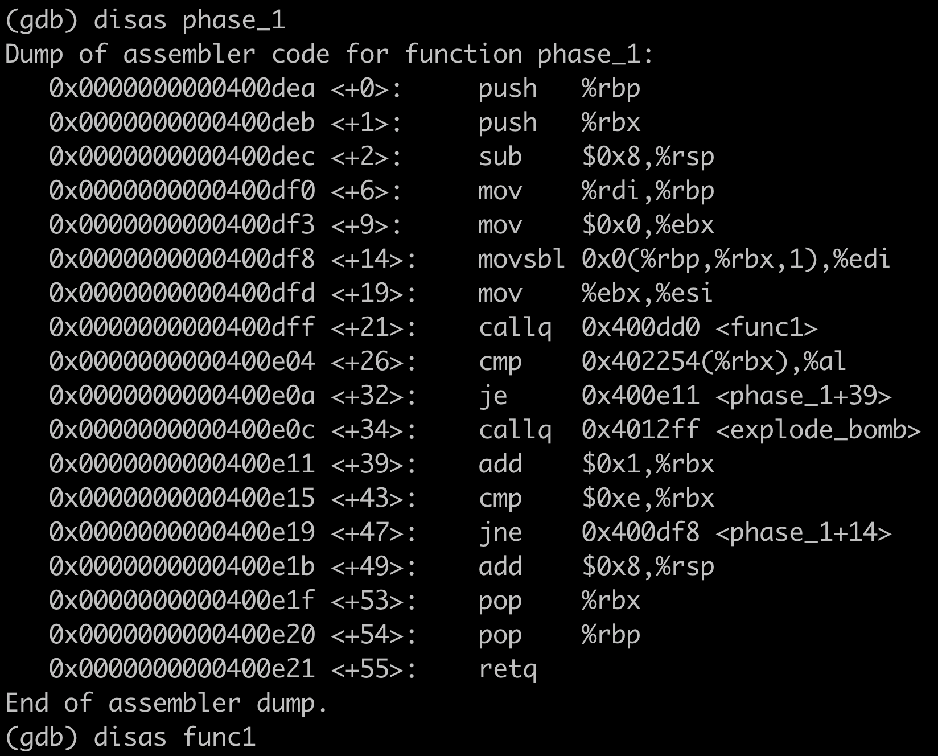
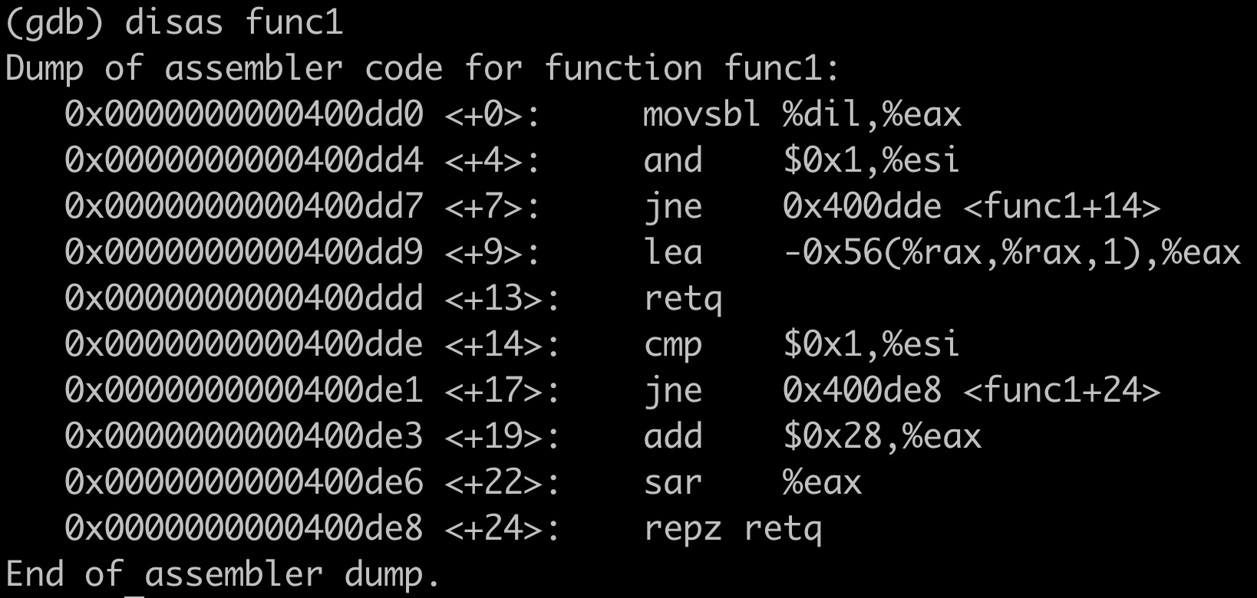
Competition
Assembly code of competition bomb

Slide 35
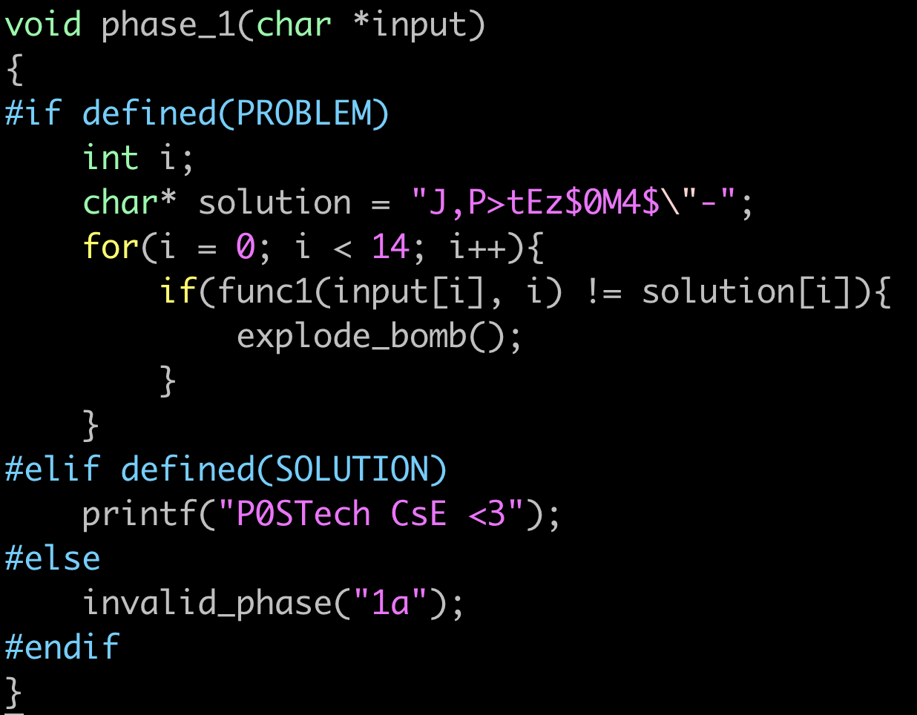
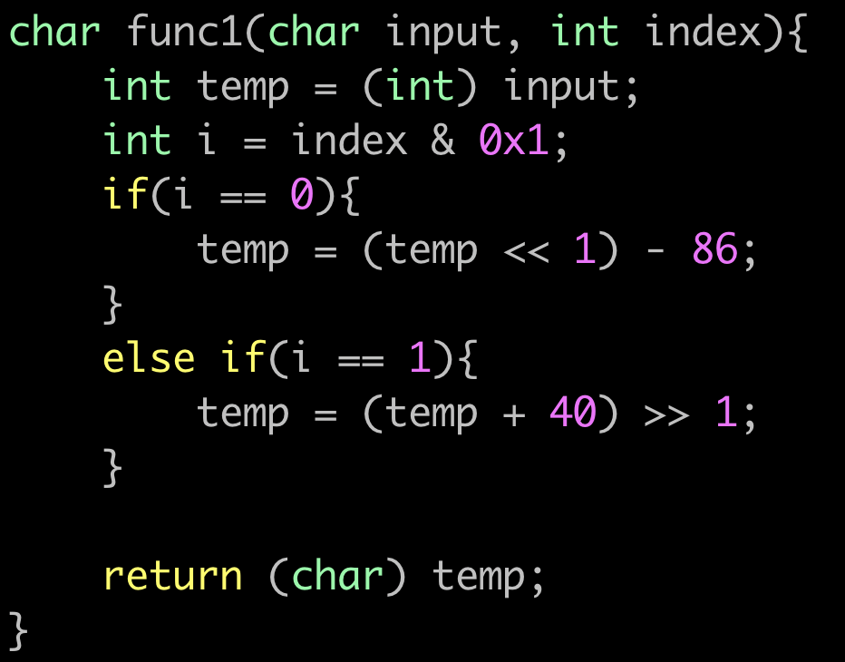
Competition
Source code of competition bomb

Slide 36
Assignment: Bomb Lab
Oh no!! Dr. Evil has written an evil program that will “explode” your programming server machines!
The program is in 6 phases, each of which reads in input – something like a password – from standard input
If your input is correct, you go on to the next phases
If not, the bomb explodes. The program prints “BOOM!!!” and terminates, and you loss half a point (Your score is updated automatically)

Slide 37
Assignment: Bomb Lab
Your goal is to defuse bomb in the given assembly file consists of 6 phases
If the bomb explode, you will get score penalty (0.5 pt.)
Due: 10/9 (Wed) 23:59 (midnight)
Late submission will not be accepted
Submit only your lab report (in pdf)
Report name: [student id].pdf (e.g., 20231234.pdf)
Briefly explain your progress in defusing the bomb. You must include:
Your bomb input solution
Your report should be less than 10 pages with font Arial and font size 11pt
Evaluation: Quiz (10 pt.) + Report (90 pt.)
The weight of each phase is for [10, 15, 15, 20, 20, 20]%
No point, If there is no explicit explanation of how you solve each phase

Slide 38
Announcement
If you submit your information, the bomb will be downloaded immediately
Bombs will be created randomly based on the order
You must download bomb only once
If you download it more than once, complete the assignment using the initially downloaded bomb
Your score will be based on the initially listed on the scoreboard
The bomb server will be opened at 9/26 (Wed) 20:30 after TA session
If there is any error in bomb server, send email to TA
No Quiz for bomb lab
It is replaced with TA session attendance

Slide 39
How to Download Bomb? (Terminal Version)
Connect to the programming server with SSH command
$ ssh -p 2022 -L 15213:127.0.0.1:15213 [YourServerID]@programming2.postech.ac.kr
-p: SSH port number to connect server
-L: Port tunneling
You can access the web server only when the SSH session is alive
Notes:
이제 기본적인 명령어에 대한 설명은 모두 끝냈고, 여러분들이 실습을 해볼 bomb을 어떻게 다운로드 받는지에 대한 간략한 설명을 해드리도록 하겠습니다. 이 bomb을 다운 받는 법은 터미널에서 다운 받는 방법과 Xshell에서 다운 받는 법 두 가지가 있지만 오늘은 앞에 있는 컴퓨터로 실습을 수행하고, Xshell을 이용해서 수행하도록 하겠습니다.
터미널 버전은 필요하신 분만 읽어보시면 될 것 같습니다.
그리고 하나 강조드릴 부분이 ssh session이 살아있어야지만 bomb server에 접속이 가능하고 bomb이 실행이 가능합니다. 그러므로 이 점 유의 부탁드리겠습니다.

Slide 40
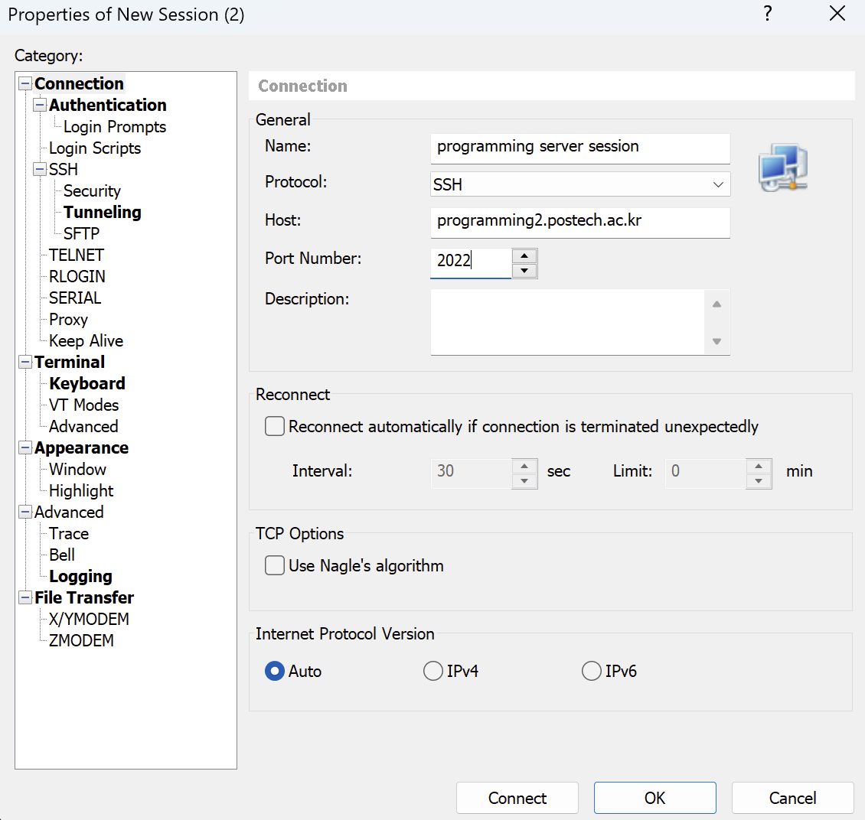
How to Download Bomb? (Xshell Version)
Create new session
Notes:
여기 부분은 저희 조교들이 이미 앞의 컴퓨터에는 작업을 해둔 부분이기에 설명만 들으시면 됩니다. programming 서버를 접속하기 위한 세션을 새로 만들어줍니다.

Slide 41
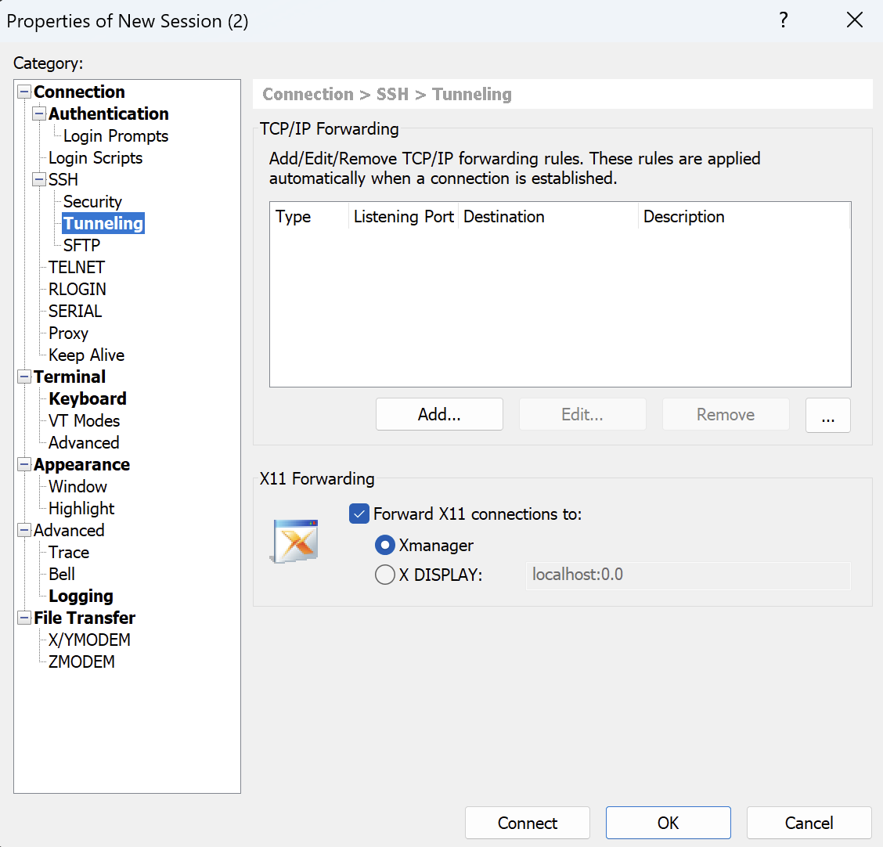
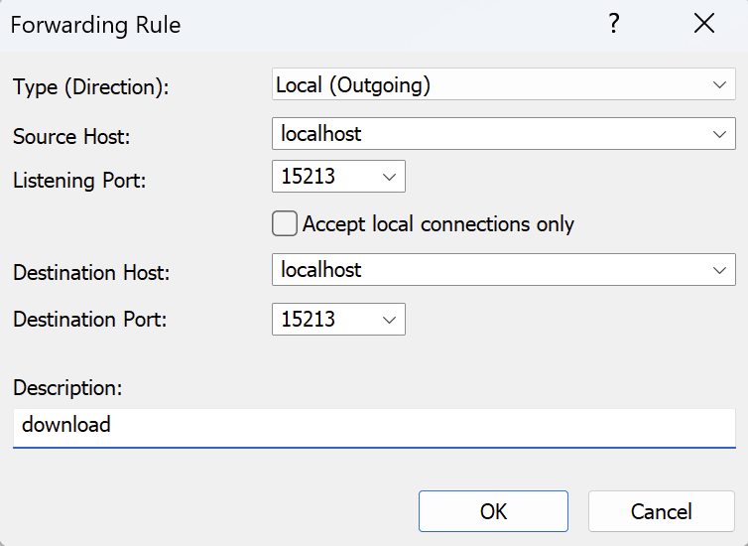
How to Download Bomb? (Xshell Version)
Go to SSH → Tunneling to setup port forwarding
Add the forwarding rule for 15213
Notes:
이후 ssh tunneling이라고 하는 탭에 들어가셔서 port forwarding을 수행할 것입니다. 이렇게 해주면 현재 여러분들이 접속하려고 하는 서버의 특정 포트가 제가 열어둔 서버와 연결이 가능하게끔 만들어줍니다. forwarding rule로 15213 port 번호를 입력하고 추가를 해주시면 됩니다.

Slide 42
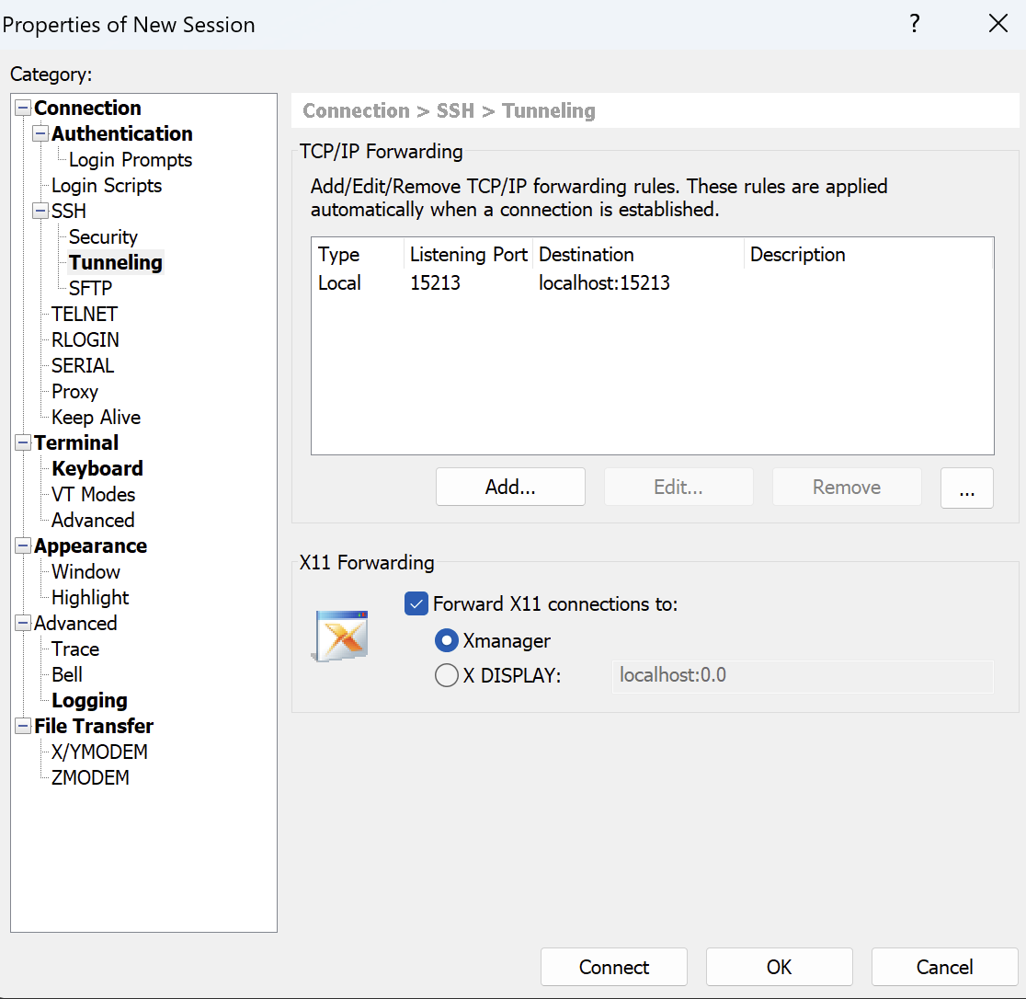
How to Download Bomb? (Xshell Version)
Notes:
이렇게 추가가 완료가 되었으면 설정이 완료가 된 것입니다.

Slide 43
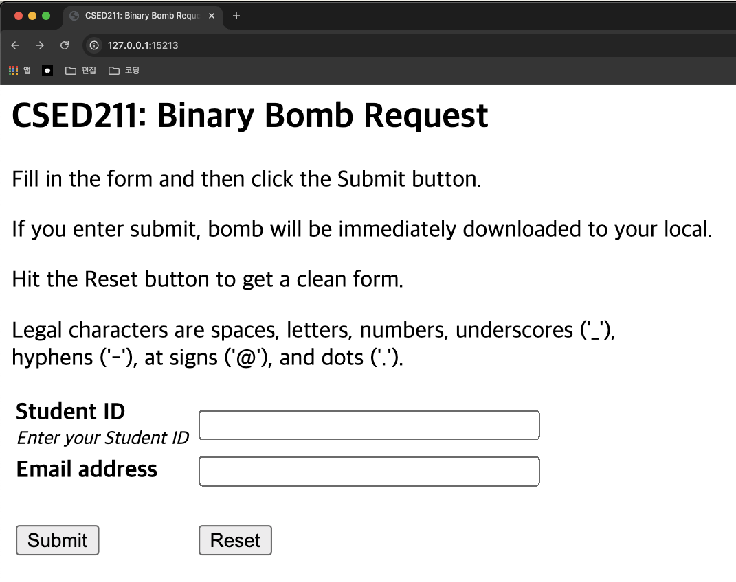
Accessing the Bomb Server
In your web browser (e.g., Chrome), search 127.0.0.1:15213
You can access the web server only when the SSH session is alive
2023XXXX
sho0927@postech.ac.kr
If you submit your information,
the bomb will be downloaded immediately

Slide 44
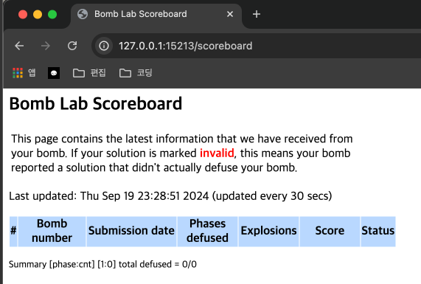
Accessing the Bomb Scoreboard
In your web browser (e.g., Chrome), search 127.0.0.1:15213/scoreboard
You can access the web server only when the SSH session is alive

Slide 45
[CSED211] Introduction to Computer Software Systems
Lab 3: Bomb Lab
Prof. Jisung Park
Seunghun Oh
2024.09.26

